Slide 1

PROJECT
PRESENTATION
CLASSIFICATION OF MYOCARDIAL INFARCTION
Notes:
Links:
https://www.pexels.com/photo/photo-of-person-holding-black-tablet-3734641/

Slide 2
Karthik Muskula Project Guide
Mounika Project Coordinator
Nalli Surjan Team Member
Prathamesh Shivaji Team Member
Shiva Kumar Team Member
Meghana Kamma Team Member
Aparna Ruturaj Team Member
Hari Shankar Team member
Project Team Structure:
Notes:
Links:
https://www.pexels.com/photo/photo-of-person-holding-black-tablet-3734641/

Slide 3
Business Objective:
Myocardial Infarction(Commonly known as “Heart attack”) is one of the most challenging problems of modern medicine. Acute myocardial infarction is associated with high mortality in the first year after it. The incidence of MI remains high in all countries. This is especially true for the urban population of highly developed countries, which are exposed to chronic stress factors, irregular and not always balanced nutrition.
The Given dataset consists of 124 variables with 1700 records of patients. Classify the Lethal outcome (cause) (LET_IS)(Y variable) by using the given dataset.
Notes:
Links:
https://www.pexels.com/photo/photo-of-person-holding-black-tablet-3734641/

Slide 4


Roadmap to Complete the Project
Data partition & Selecting few models
Model Evaluations & select best model
Model deployment
Data cleaning or data preprocessing
Data Transformation
Exploratory data analysis
Collecting and reading the data
Notes:
Links:
https://unsplash.com/photos/fzOITuS1DIQ

Slide 5
Action plan:
Sl.No | Action | Sub Action | Responsibility | Target date | Status | Remarks
1 | Frame the problem | Identify the problem | All | 26th July | Closed
2 | Collecting and reading the data | Collect the data and understand the data | All | 29th July | Closed
3 | Exploratory data analysis | Analyze and summarize the main data sets | All | 1st Aug | Closed
4 | Data cleaning or data preprocessing | Remove unnecessary columns/rows like Nulls,NA,NAA, unusual values and etc. and Fill Nulls,NA,NAA with Mean or meadian or mode or others. | All | 3rd Aug | Closed
5 | Data Transformation | Converting the data into usable format or change the scaling | All | 5th Aug | Closed | PCA selected for analysis
6 | Data partition | Splitting the dataset in to known and unknown data sets. | All | 7th Aug | Closed
7 | Selecting few models | Select the best suitable models from machine learning models | All | 8th Aug | Closed
8 | Cross validation of chosen models | Re verify the selected models before any conclusion on the results | All | 11th Aug | Closed
9 | Evaluation of all models and selecting the best model | Compare the accuracy of the results with the actuals, then select the best model and do the evaluation again with diff data sets for performance | All | 11th Aug | Closed
10 | Prediction on new data by deployment | Final predictions for the data which is unseen data | All | 18th Aug | Closed
Notes:
Links:
https://unsplash.com/photos/fzOITuS1DIQ

Slide 6
COLLECTING & READING THE DATA
The Given dataset consists of 124 variables with 1700 records of patients. Classify the Lethal outcome (cause) (LET_IS)(Y variable) by using the given dataset.
Data Information:
Range Index: 1700 entries, 0 to 1699
Columns: 123 entries, AGE to LET_IS
Data Types: float64(110), int64(13)
Memory Usage: 1.6 MB
Duplicated Rows:
Number of Duplicated Rows: 0
Additional Note:
The "ID" Column: It can be neglected as it is a reference to patients.neglected because It is a reference to patient
Notes:
Links:
https://www.pexels.com/photo/photo-of-person-holding-black-tablet-3734641/

Slide 7
EXPLORATORY DATA ANALYSIS
Box plot for overall data set: To know the variable wise data range & Outliers through visually
Data set description: Variable wise statistical summary table
Density plot: Show the specific visualization details such as column names, data range, etc.
Variable wise unique value count visually
Variable wise percentage of Null Values
Data set visualization(Null vs Values)
Data set visualization(Variable wise Nulls vs Values)
Correlation between Variables visually
Pie chart for gender
Bar graph for age vs LET_IS(outcome)
Notes:
Links:
https://www.pexels.com/photo/photo-of-person-holding-black-tablet-3734641/

Slide 8
DATA CLEANING OR DATA PRE-PROCESSING
Dropping top columns, which having high null values
Filling missing values of columns having null count less than 112 with the help of interpolation technique
Filling remaining missing values of remaining columns with the help of fillna() function and median central tendency
Correlation after data preprocessing to know the relationship and visualizations
Note: from above correlation graph we did not find any high correlated variables with outcome and having more independent variables(High dimensional data set), so we will go with dimensional reduction techniques
Notes:
Links:
https://www.pexels.com/photo/photo-of-person-holding-black-tablet-3734641/

Slide 9
DATA TRANSFORMATION
Applying Principal Component Analysis(Dimensional reduction technique) to reduce the number of independent(X) variables.
PCA and Feature Selection:
We utilize PCA to determine the optimal number of columns for 'k' in SelectKBest().
The Select Best() method aids in feature selection and engineering tasks.
Accuracy Assessment with KNN:
We employ the K-Nearest Neighbors (KNN) algorithm.
It helps us understand how varying the number of columns impacts the model's accuracy.
Shape of the data before PCA (1700, 119)
Shape of the data after PCA (1700, 11)
Notes:
Links:
https://www.pexels.com/photo/photo-of-person-holding-black-tablet-3734641/

Slide 10
DATA PARTITION
Splitting the dataset in to known and unknown data sets.
In the ratio of 70%(Known) and 30%(Unknown)
Shapes of the data train(known) and test(unknown)
Notes:
Links:
https://www.pexels.com/photo/photo-of-person-holding-black-tablet-3734641/

Slide 11
FINAL MODEL BUILDINGS & EVALUATION
Model buildings with for loops and their Accuracy scores:
XGBOOST (Extreme Gradient Boosting) preforming very good compare to other classification models with 98% accuracy.
Sl.No | Model Name | Accuracy%
1 | XGBOOST | 98%
2 | KNN | 93%
3 | SVC | 84%
4 | Random Forest | 97%
6 | Naive_Bayes | 41%
Notes:
Links:
https://www.pexels.com/photo/photo-of-person-holding-black-tablet-3734641/

Slide 12

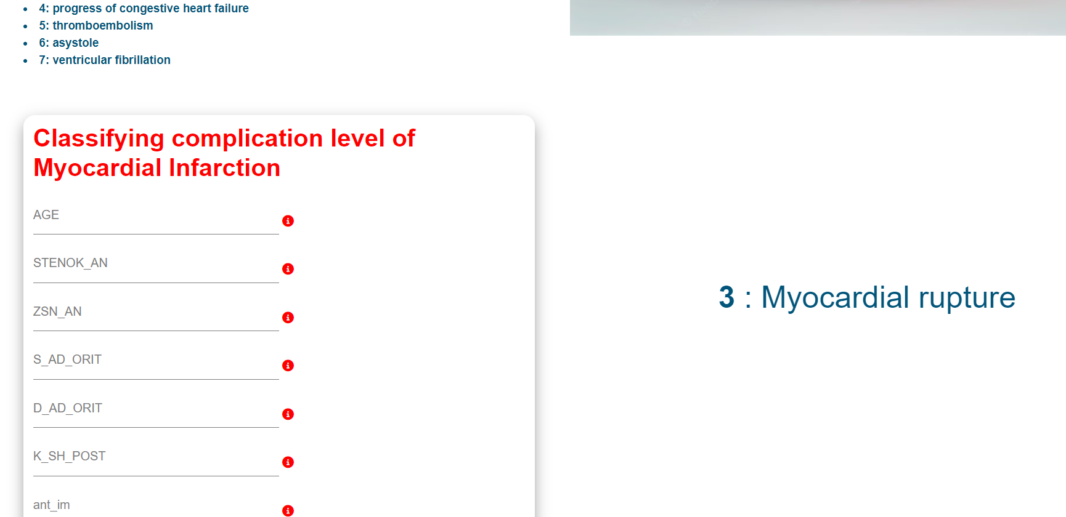
MODEL DEPLOYEMENT
Integrating ML Model into Django and Deploying to Heroku
Screenshots from web
Web address:
https://myocardial-infarction-bae0828dfd3d.herokuapp.com/predict
Notes:
Links:
https://www.pexels.com/photo/photo-of-person-holding-black-tablet-3734641/

Slide 13
Thank You
Notes:
Links:
https://www.pexels.com/photo/photo-of-person-holding-black-tablet-3734641/

